Slide 1







Public crowd-sensing of heat-waves by social media data
Heatwaves’ impact in Italy during summer 2015 by twitter social media audit.
Valentina Grasso (1,2), Alfonso Crisci (1), Marco Morabito (1), Paolo Nesi (3) and Gianni Pantaleo (3)
(1) CNR Ibimet, Italian National Research Council, Florence, Italy (v.grasso@ibimet.cnr.it)
(2) LaMMA Consortium, Italian National Research Council, Florence, Italy.
(3) DISIT Lab, Distributed [Systems and internet | Data Intelligence and] Technologies Lab, Dep. of Information Engineering (DINFO), University of Florence, Italy
16th EMS Annual Meeting & 11th European
Conference on Applied Climatology (ECAC)
| 12–16 September 2016 | Trieste, Italy
Where atmosphere, sea and land meet:
bridging between sciences, applications and stakeholders

Slide 2

Backgrounds
Background and Aims
Social media data become an unique realtime informative source to be used to monitor the impacts related of meteoclimatic events.
Heat wave is the one of main issue in relation to the climatic hazard on population.
The investigation on the reliability of social media content in relation to the crowd perception of natural risk as heat-wave is good topic.
A methodological approach where data tools and framework give an effective exploitation of crowd-sensed data in regard to heat related hazard is a need today.

Slide 3

Aims of work
Background and Aims
Are the environmental hot conditions ( heat-wave) associated to semantic related social media (SM) streams?
Does SM activity “follow” the spatial and temporal patterns of heatwaves (HW) in Italy?
Is a climatic daily classification ( as HW days) able to discriminate different level of local SM activity?
Do exist a social media sensitivity linked to local climatic parameters?
These are the basic questions to define the reliability of social media analytics to perform a real-time monitoring the impact of heatwave.
In the work will try to give some answers.

Slide 4

Weather based HeatWave status definition
Social media data DISIT Platform
It is a prolonged period of excessive heat, often combined with excessive humidity lasting 2-+ days. Critical day definition for a generic location and season is needed.
EU-project EUROHEAT(*) approach was adopted improving local daily climatologies (1981-2010) . It states that Critical day occurs when:
Tmax Apparent_{jd}> Tmax Apparent_{jd} 90th
Tmin _{jd} > Tmin _{jd}90th & Tmax Apparent_{jd} > median Tmax Apparent_{jd}
* D’Ippoliti et(2010) Environ Health. "The impact of heat waves on mortality in 9 European cities: results from the EuroHEAT project."
Heat Wave is when critical days spell exceed 2 days. The HW features are: duration (days) , intensity (T° > treshshold), seasonal precocity ( jd timing) and spatial extent.
Image from: https://www.er24.co.za/blog/heat-wave-be-cautious/

Slide 5
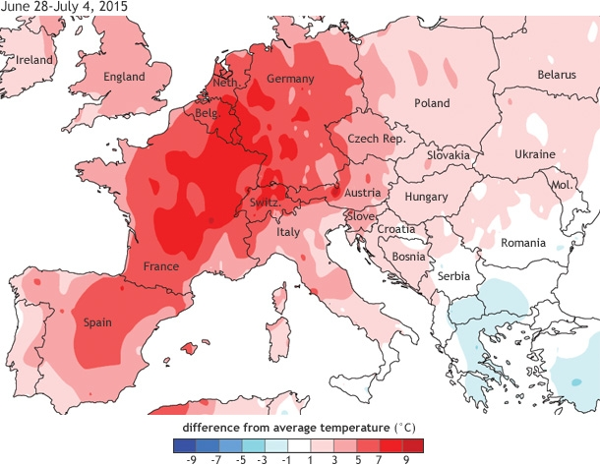
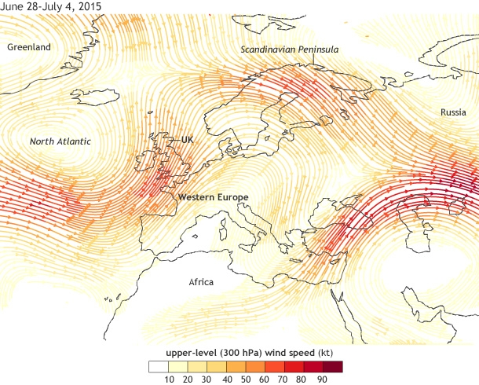
Heat wave 2015 in Italy
Five main heatwaves episodes have occurred in Italy during summer 2015. The main one hits in July maintaining a persistent character for 1 months in reason to a atmospheric blocking ( “omega block”). North Thyrrenic regions are the most impacted in July. The agust’s episode have involved the southern eastern areas ( mainly Apulia and Calabria).
Web reference https://www.climate.gov/news-features/event-tracker/summer-heat-wave-arrives-europe

Slide 6


Performing crowd-sensing by Twitter data
On-line multilanguage platform for social-networking and microblogging.
Twitter data perform significant crowd-sensing.
Who feed information in ?
Many and various
6.4 million of active users in Italy (2015)
Citizen, Institution, Institutional Public Services, Business Companies, Community - NGO organization, Media,Conversational Bots and Sensors Bots.
Daily activity common metrics
RTW_TW: N° of tweets & retweets
RTW: N° of tweets & retweets
TW: N of native tweets & retweets
U_native_users: N° of native TW authors
U_full_user: N° authors of TW & RTW
U_unique_hashtag: N° of hash-TAG

Slide 7
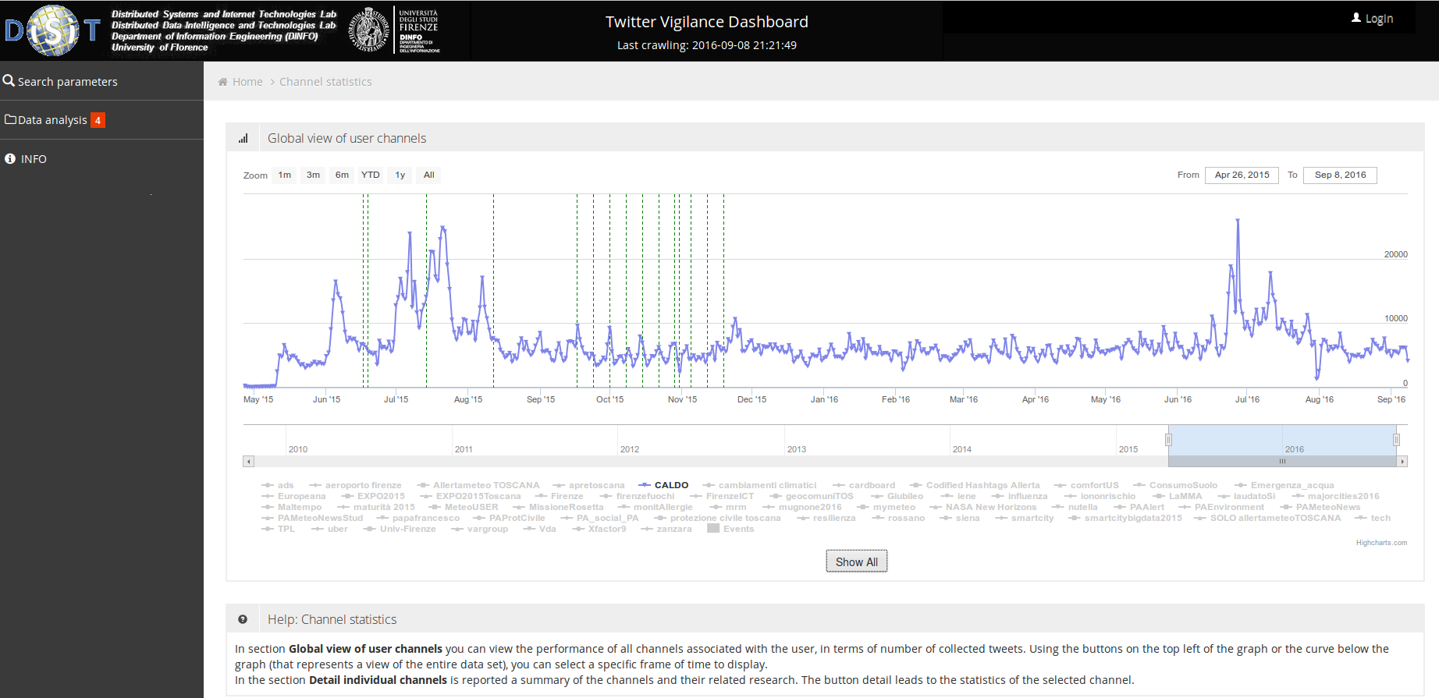
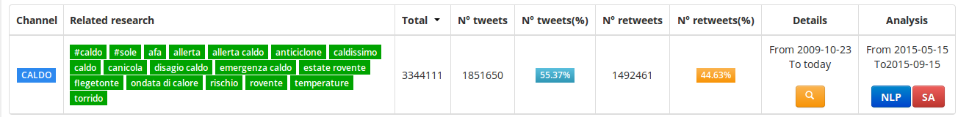
Twitter Vigilance DISIT Platform
Twitter VIgilance platform is an environment developed by DISIT University of Florence that:
Manage multiple queries in twitter API
Store the data of messages collected by user defined queries -> channel
It is a dashboard able to visualize data collecting process & analytics of twitter metrics of channel
Social media data: Channel “CALDO”
http://www.disit.org/tv/
http://www.disit.org/tv/index.php?p=chart_singlechannel&canale=CALDO

Slide 8
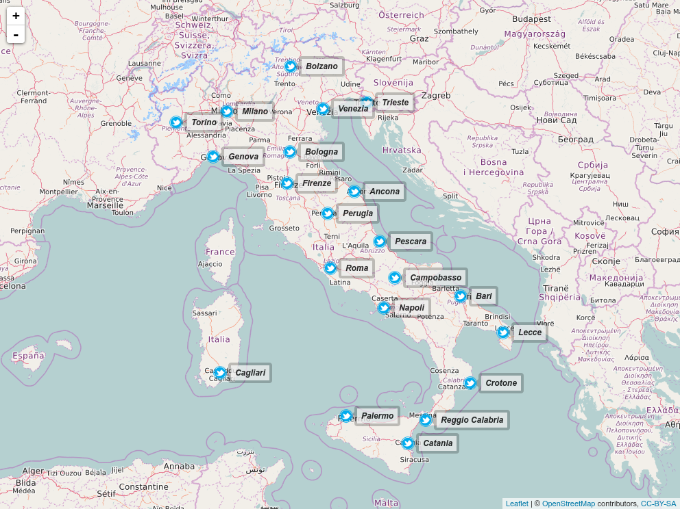

Location considered : workflow weather for twitter data.
GSOD [1] daily weather data for 21 italian location are acquired corresponding to main city for each region.
Daily Max T° Apparent are assessed by using Steadman [2] approach.
Daily normals & quantile (1981-2010) are performed for Tmin and Tmax by using 31-day window for JD.
Critical days and Heatwave days are calculated for the period ( 2015-05-15 / 2015-05-15). N=124.
Statistics for each region are calculated.
Climatic analysis are carried out to link outcomes with social media data for the period investigated (15 May to 15 September).
Main city are considered as representative
of own region.
[1] https://data.noaa.gov/dataset/global-surface-summary-of-the-day-gsod
[2] Steadman, R.G. 1984. A universal expression of apparent temperature. J. Appl. Meteor. 23, 1674-87

Slide 9
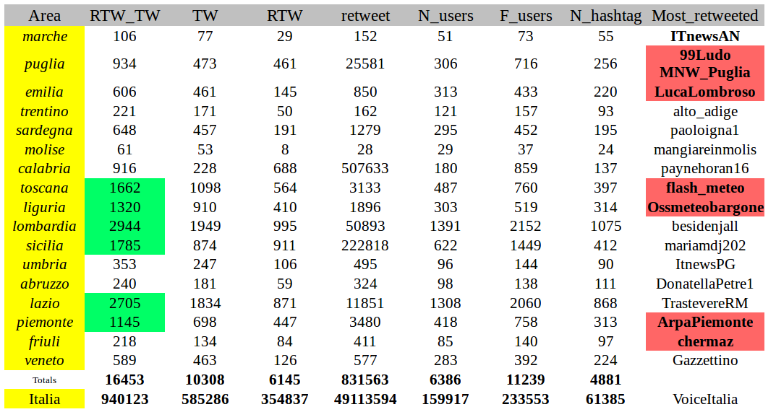
Channel “caldo” data and geo-extraction of local twitter streams.
Original Twitter Channel “Caldo” are filtered matching message containing the heat related words ["caldo","afa","canicola","sudore","caldissimo","torrido","record","allarme","emergenza","bollino","bere","anziani","sete","umidità","sudore","anticiclone","disagio","canicola","caronte","umido","flegetonte","sudo","sudato"] . FIltered Channel “Caldo” is indicated in table as “Italia”.
Local streams are originated by a further geographical key-term filtering by the using terms linked to location considered [ “city name”,”region name”].
For each tweets collection the daily metrics of activity is calculated.
Daily data are merged with the respective local weather data.

Slide 10
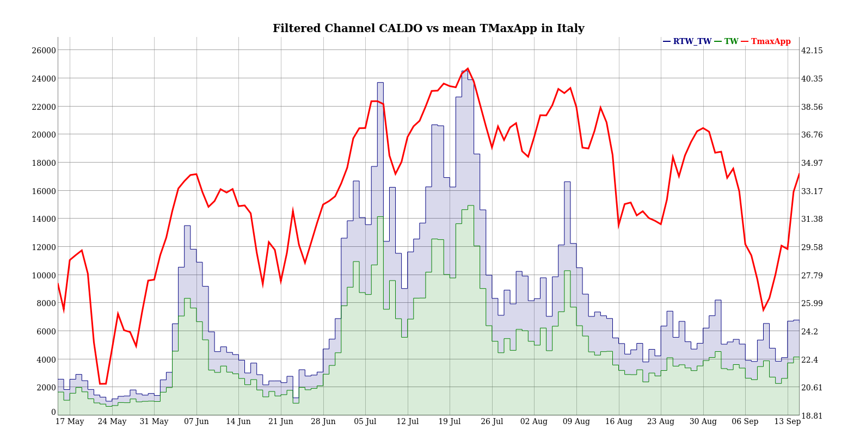

Channel “Caldo Italia” and Heatwave periods 2015 (15 May to 15 September)
C
D
B
E
A

Slide 11
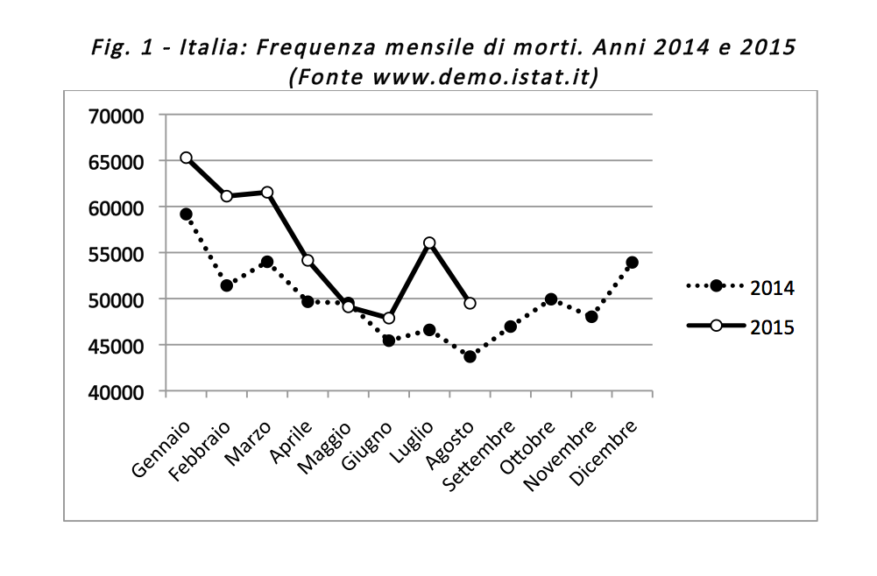
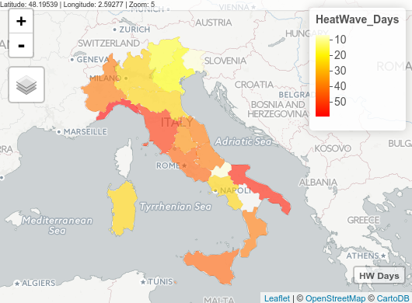
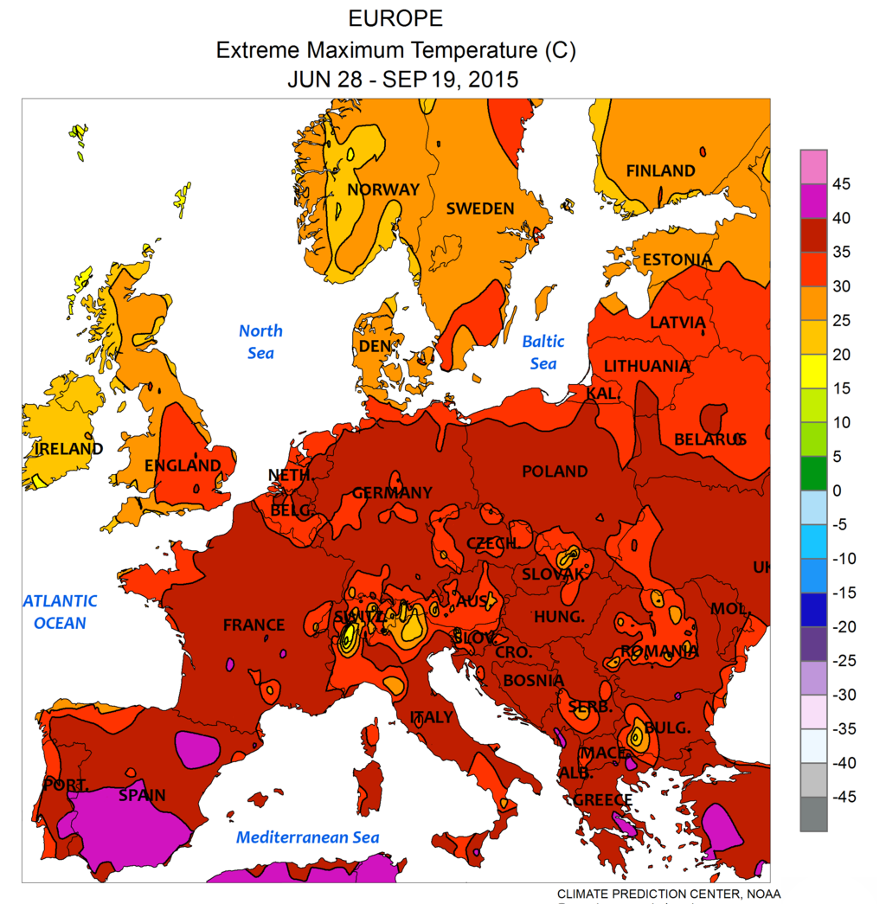
The long and intense HeatWaves 2015: a very deep impact in Italy.
http://www.neodemos.info/68-mila-morti-in-piu-nel-2015/
Image from Wiki Commons 2015 European Heat wave.
https://commons.wikimedia.org/wiki/Category:2015_european_heat_wave?uselang=de

Slide 12
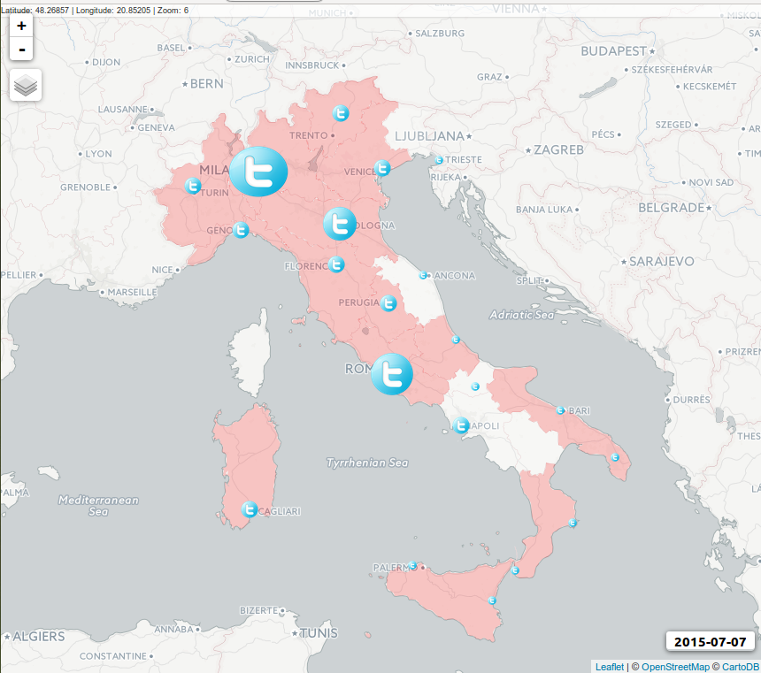
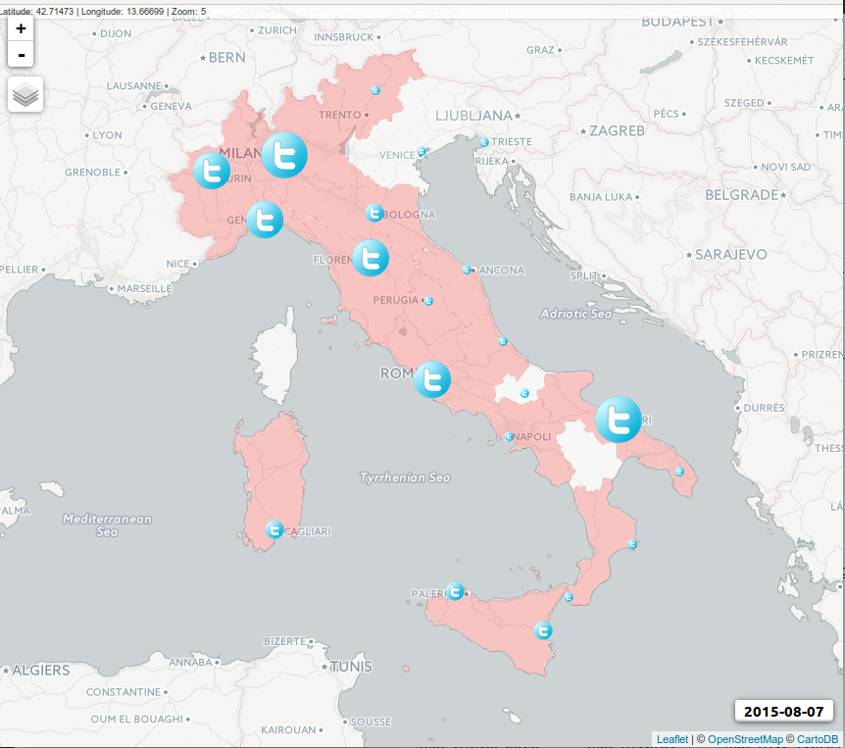
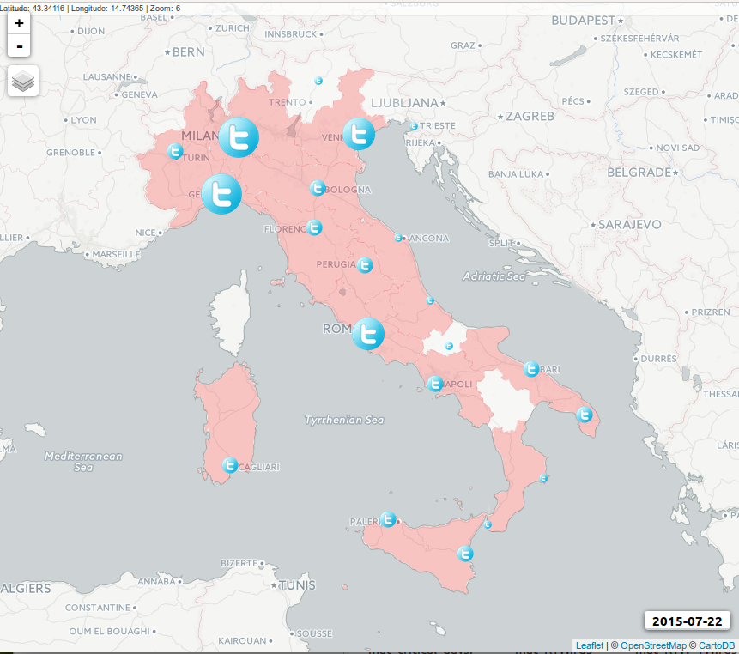
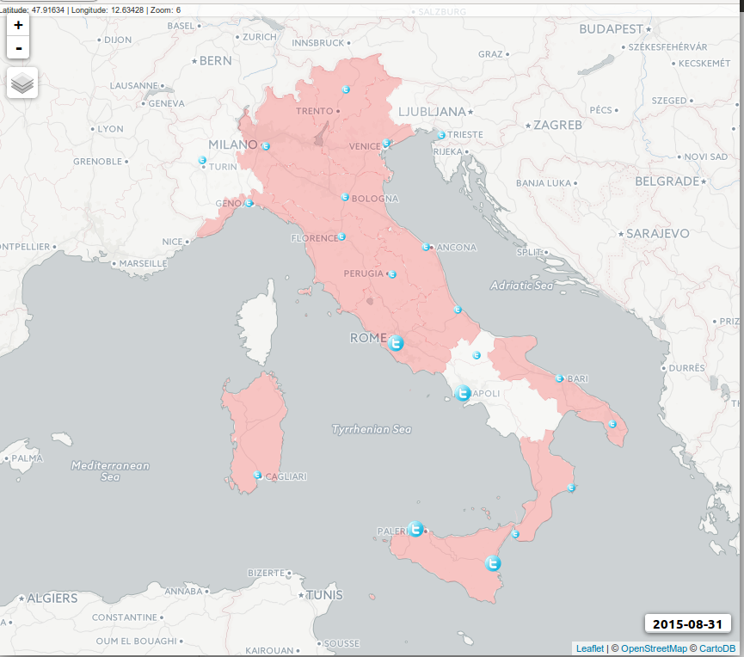
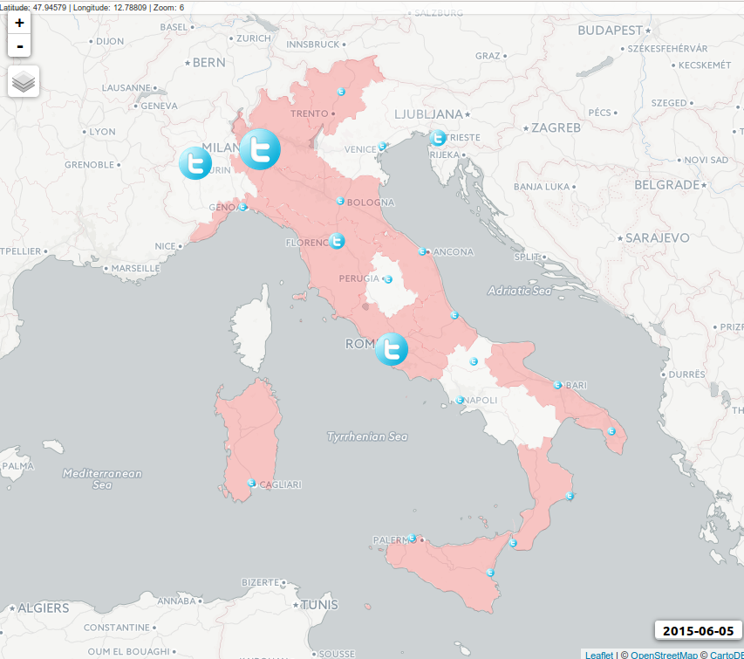
Social Response Pattern during peak days
Twitter social response are influenced not only by heatwave conditions but it is also strongly dependent by population density.
B July
D August
A Jun
C July
E August

Slide 13
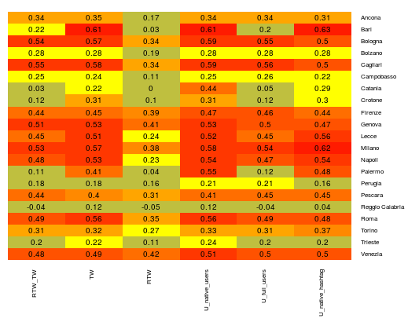
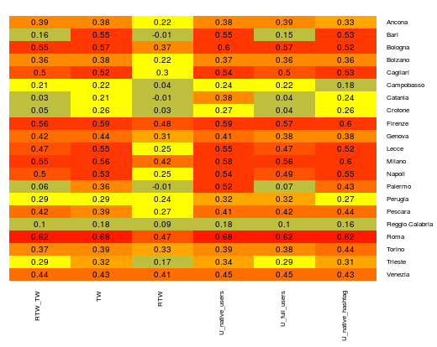
Association between daily Twitter Metrics ( RTW_TW, TW, RTW, native_users, full_users, N hashtag)
and main HW parameters by cities.
Linear Correlation between daily values in 15 may-15 september. N=124 . Minimum Level of significance r( 0.05) ~ 0.15
Daily Minimum temperature
Daily apparent maximum temperature

Slide 14
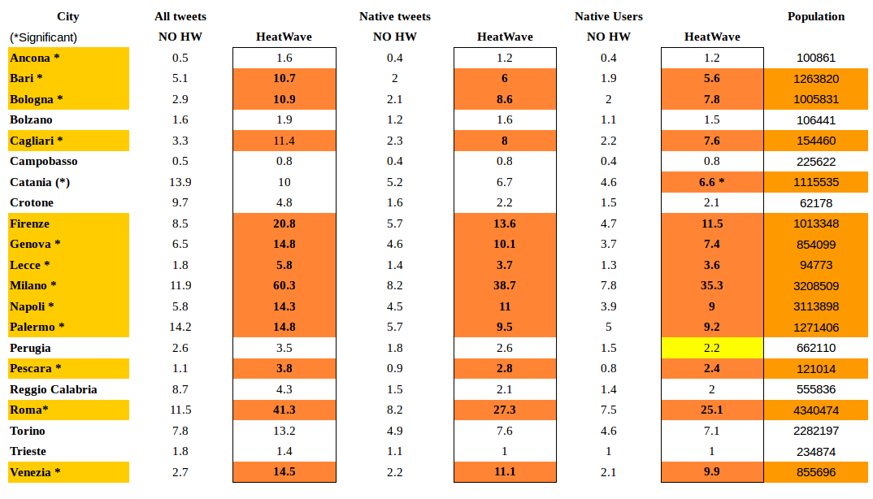
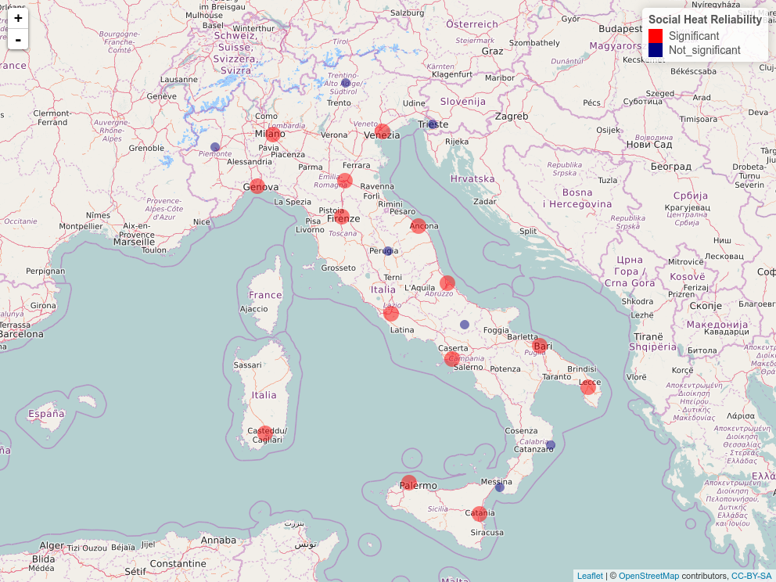
HeatWaves and daily social reliability (how & where: t-student comparison & map)

Slide 15
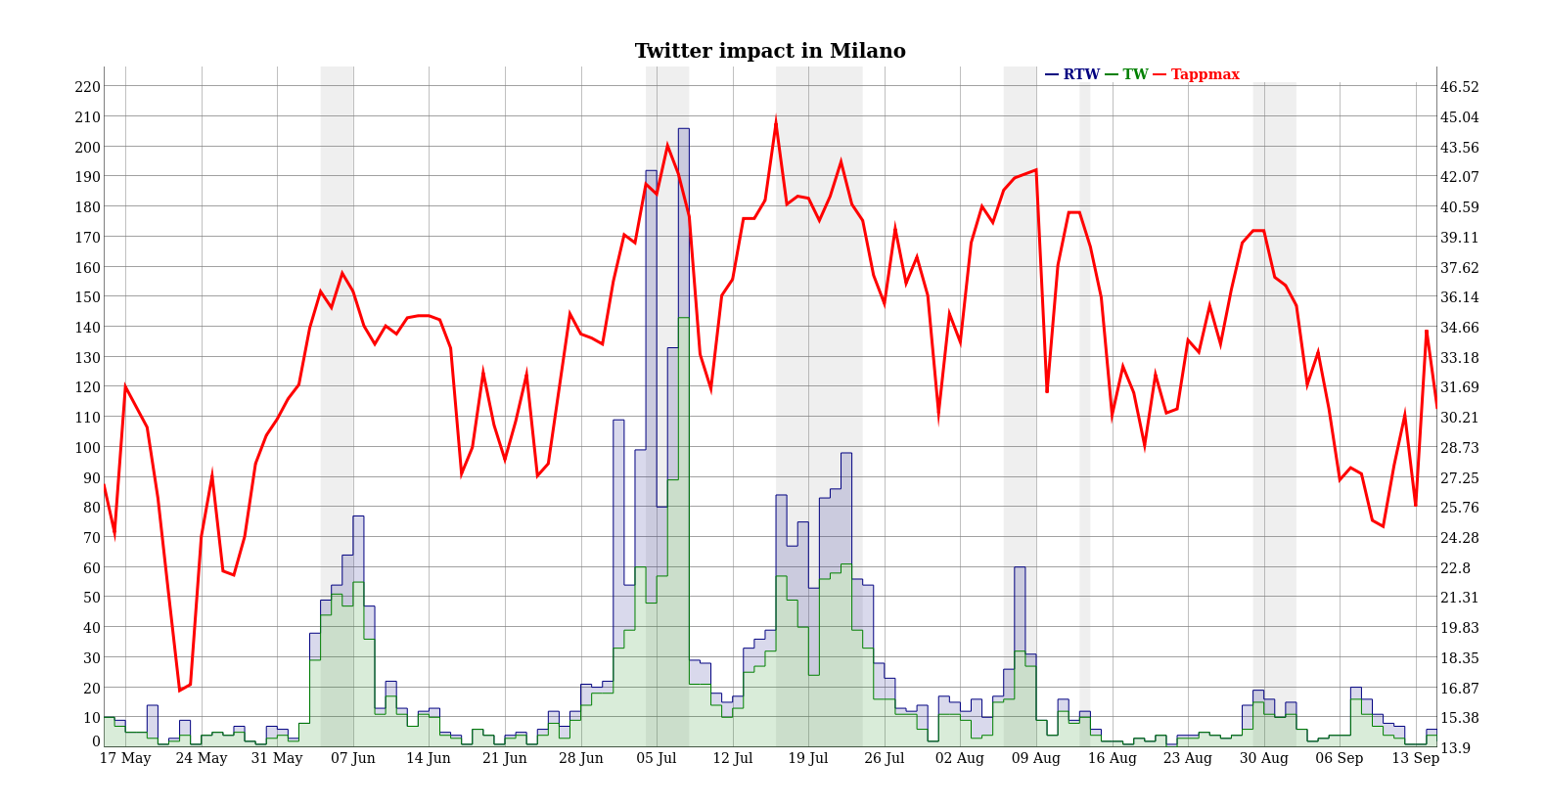
HeatWaves and daily twitter activity Milano
B
C
D
E
A

Slide 16
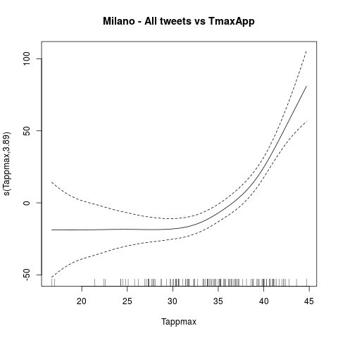
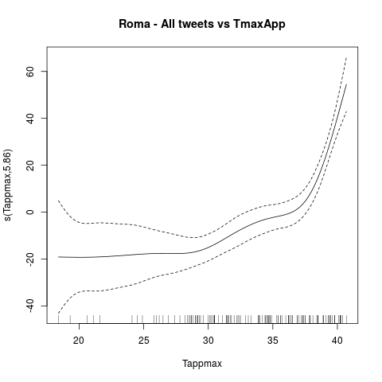
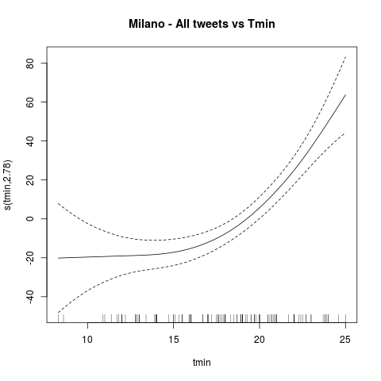
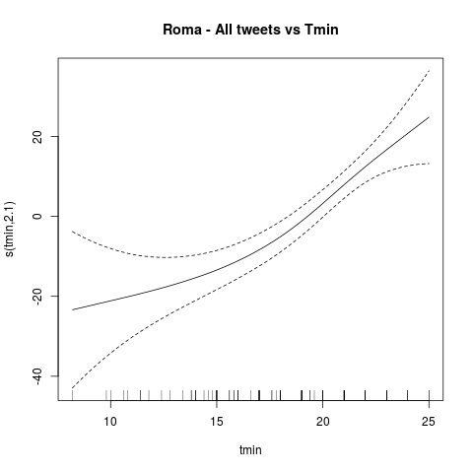
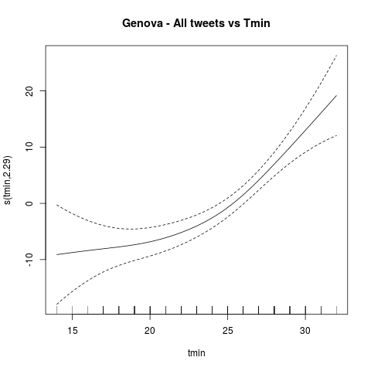
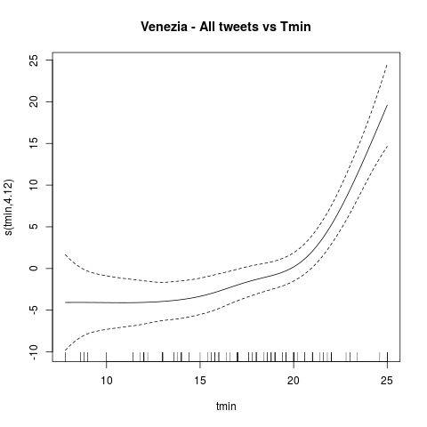
Parametric sensitivity of local daily twitter flows (GAM models Threshold is X the when Y>=0)
Inlands cities show threshold around 35°C in TMax App.
Analysis suggest that coastal areas have more higher threshold in Tmin (25°C and more).
These considerations are valid where association between HeatWave and tweets is significant. Further investigations are needed.

Slide 17
Seven points remarks
Social media (SM) data collection require right search-terms to obtain suitable data. the semantic tuning of TW channel is ever required. Platforms as TwitterVigilance are useful.
Channel as “Caldo” have followed well the italian summer thermal profile in 2015. HW events are easily recognizable following channel activity.
Simple local SM stream obtained by geo-term filtering, could be reliable only in a medium-large city context ( > 800.000 ab) to reach an adequate SM data numerosity.
SM data suffers a strong dependence with population density. This is a considerable limit when SM data are used outside of big metropolitan areas.
When data numerosity is adequate the association SM activity vs HW parameters is detected as significant. Moreover HW status ( with some exception) implies ever higher level of SM activity.
SM flows exhibits often a spatial pattern following the timing and the extent of HW phenomenon.
SM sensitivity activity vs HW parameters is statistically detectable. In large urban areas SM data could be an help to evaluate quantitatively the impact of phenomenon as HW and disaster response.

Slide 18






Contacts
Communication analyst
Valentina Grasso
grasso@lamma.rete.toscana.it
v.grasso@ibimet.cnr.it
http://www.lamma.rete.toscana.it
http://www.ibimet.cnr.it/
Biometeorology
Alfonso Crisci
a.crisci@ibimet.cnr.it
alfcrisci@gmail.com
@alf_crisci
Marco Morabito
marco.morabito@unifi.it
http://www.ibimet.cnr.it/
Informatics Science
Paolo Nesi
paolo.nesi@unifi.it
Gianni Pantaleo
gianni.pantaleo@unifi.it
http://www.disit.org/
http://www.disit.org/tv/
Data & Code: https://github.com/alfcrisci/EMS_heat_twitter
Image from :https://commons.wikimedia.org/wiki/File:Thank-you-word-cloud.jpg

